Slide 1
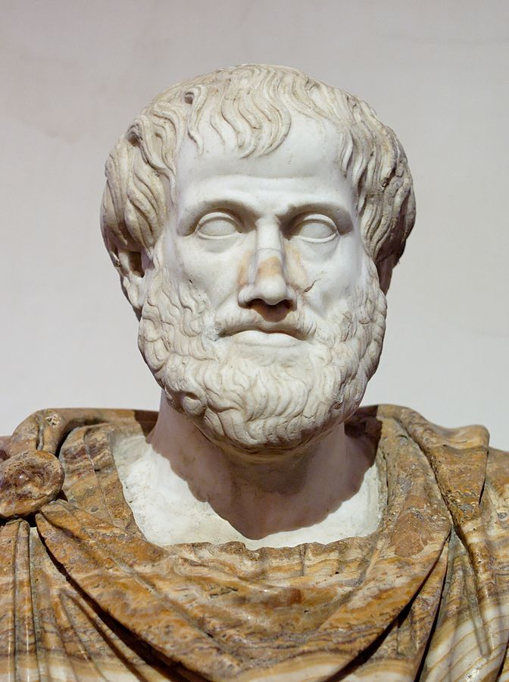
photo: en.wikipedia, pubic domain Aristotle on Adversity by Albert Fried-Cassorla a presentation given on 6-11-20 Also see a recorded video of this at https://www.youtube.com/watch?v=3pN1Z7Lam10

Slide 2
Aristotle on Adversity
Objectives of this presentation
Many books have been written on Aristotle’s Ethics, and excellent videos recorded.
This will, I hope, add a uniquely useful resource
Much introductory material will be general background, familiar to some
The unique dimension will be how to make Aristotle’s views on Virtue and Happiness a part of everyday life, and now they can help us overcome adversity
Those ideas will appear in the later portions of this 10 minute presentation – so hang in there!
An excellent book on the subject is Aristotle’s Way by Edith Hall, to which I am indebted.

Slide 3
Aristotle on Adversity
Brief Background
Son of a master physician, so primed for a life of science
Third in a line of major Greek philosophers, preceded by Socrates and Plato
Father was court Physician to Philip II
Aristotle was tutor to Alexander the Great

Slide 4
Aristotle on Adversity
Brief Background, continued
Wrote extensively on logic, ethics, physics, biology, metaphysics, esthetics, poetry, government and much more.
Considered a polymath, one of the greatest thinkers who ever lived
No need to accept all of his views, many of which are either flawed, undemocratic, prideful, or worse
We SHOULD recognize that his scope was encyclopedic, his work pioneering, his insights breathtaking (example: anticipating DNA); and the scale of his labors were unprecedented. He had the support of Alexander in is biological research to the tune of $16 mm in today’s money
Not rivalled for thousands of years, if then.

Slide 5
Aristotle on Adversity
Brief Background, continued
This presentation focuses chiefly on Aristotle’s life an ethics as expressed in the Nicomachean ethics. He also wrote the Eudemian Ethics and other texts on ethics.
Aristotle was not a perfect man ethically, especially on a political level by today’s standards. (Compare with Thomas Jefferson, 1700 years later.)
a toady to two monarchs
an advocate of slavery
a male chauvinistic, and more.
anti-democratic –believed Democracy was the worst form of government
Then why study Aristotle? Because there is so much that is good and useful in understanding ourselves and the world.

Slide 6
Aristotle on Adversity
Key beliefs on
Happiness and Adversity
The optimum goal and main, non-reducible goal of human existence in eudaemonia.
EUDAEMONIA is human flourishing. This is relevant today. The struggle for it beats back adversity.
Other goals are intermediary
ADVERSITY is rarely addressed as such except as the obverse of a flourishing life
DELIBERATION helps us make the right choices
How can you tell if a human is happy? Solon, lawgiver of ancient Athens, said only when someone is dead can you evaluate their lifetime happiness. Aristotle disagrees. Says you can live the eudaemondic life NOW.
photo: morguefile.com

Slide 7
Aristotle on Adversity
Key beliefs on ETHICS and MODERATION
ETHICS is the key – developing Intellectual and Moral Virtues (see next slide). Ethics help guide a person to the most virtuous choices
Moderation is needed to steer between excessive qualities.
REASON is the chief quality that distinguishes us from other animals and is the most important quality we have. Using REASON is most important and virtuous guide to the Eudaemonic life.
Example: Think of any undesirable trait in yourself or others
Likely a lack of moderation is involved -- either excess or deficiency.
Ditto for traits we admire in ourselves and others!
He seeks the Golden Mean and advises us to do so as well.
This works very well, with exceptions. Example: Was Michelangelo excessive in spending so much labor on the Sistine Chapel
Aristotle believes strongly in the value of friendship. Once risked his life with Alexander, protesting killing of Calisthenes. This ended his relationship with Alexander. Friendship within limits. Certainly not with inferiors, plebians.

Slide 8
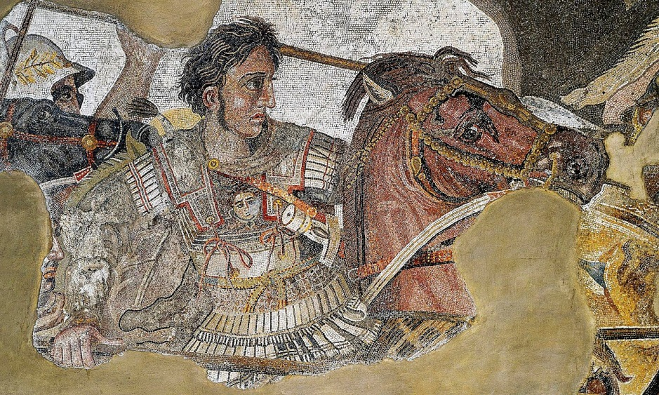
Aristotle on Adversity
Key beliefs on DEMOCRACY
As mentioned, Democracy is the worst form
of government, after Monarchy and Aristocracy
Yet he DID believe in community – opened his lectures to the town at large
Wrote exoteric works, for the masses, as opposed to esotetic, for the learned
Supported monarchs and autocrats almost all his life – until he personally was endangered
Supported Slavery
Thought each class had its role and appropriate station
Was a member of an upper class family
Enemy of women’s rights – but treated his own wives well
photo: en.wikipedia, pubic domain

Slide 9
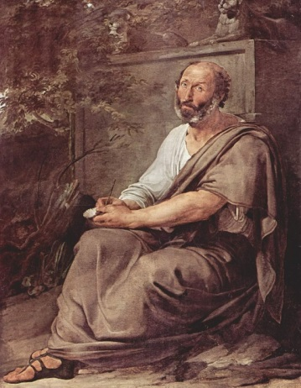
Aristotle on Adversity
photo: en.wikipedia, pubic domain
VIRTUES - they are the path to flourishing
Be a good person and all else will follow
Intellectual Virtues – must be taught
Moral Virtues – not innate. Must become habit.
“Ethos” means habit in Greek. Etymonline.com: from Greek ēthos "habitual character and disposition; moral character; habit, custom; an accustomed place,"
Do the right thing enough and you become it. Do the right thing over and over again and it becomes Second Nature, a phrase coined by Aristotle. From Augustine, following medieval Aristotelian thought.
Model your self on people you admire.

Slide 10
Aristotle on Adversity
The Golden Mean is the beauty point between excess and deficiency. Aristotle asked Alexander what he thought the best quality to have was. He said “Courage. “ Aristotle said that this would not do in battle when facing overwhelming opposition. Knowing when to be courageous – having judgment – was best. Alexander agreed.
The Virtues are our guide – finding the mean in each situation and quality. This is our defense against adversity.
The virtuous life is the happy life – although not if one is hit by extreme misfortune. Example of Priam, who lost his son and his kingdom.
Determined Recollection – a technique for improving happiness - not available to other animals

Slide 11
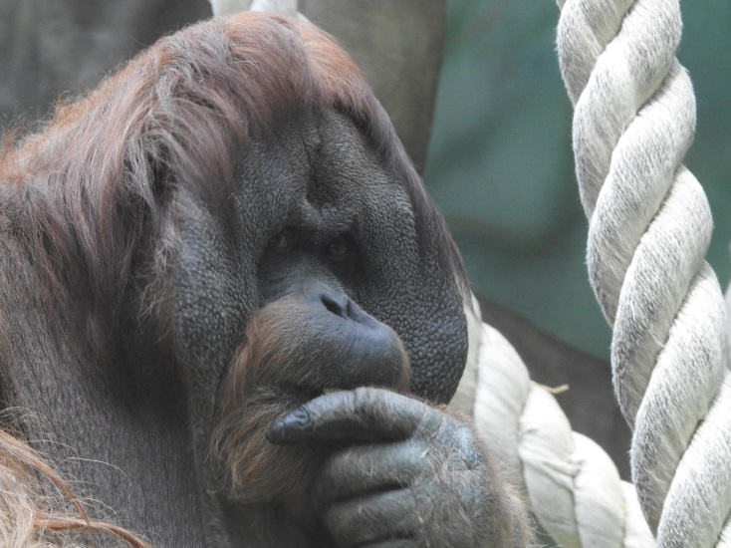
Aristotle on Adversity
VIRTUES – they are the path
to human flourishing
The contemplative life –
the best life
Determined Recollection – a technique for improving happiness, overcoming sadness, adversity - not available to other animals
Living Well – integrating all of these virtues
Blessedness – only available to philosophers; art, religion not recognized as equal pathways
photo: morguefile.com

Slide 12
photo: Wikipedia – “Happy Children Playing”
What can we take from Aristotle?
The contemplative life – the best life… Or at least an aspect of YOUR Eudaemonic life
Be ethical - in a modern way – avoiding excess except when appropriate
Use Determined Recollection – as a happiness-enhancing tool
Live Well – integrating all of these virtues, especially leisure and community

Slide 13
Resources
Nicomachaean Ethics by Aristotle
Aristotle’s Way by Edith Hall
The Story of Philosophy by Will Durant
The History of Western Philosophy by Bertrand Russell
Stanford Encyclopedia on Philosophy: Aristotle’s Ethics: https://plato.stanford.edu/entries/aristotle-ethics/
http://classics.mit.edu/Aristotle/nicomachaen.9.ix.html
And MANY Youtube videos, including ones by or featuring Edith Hall, Peter Adamson (who has an excellent podcast series), Crash Course Philosophy, Bertrand Russell, and many others

Slide 14
Post event comments by friend, Prof. Jeff Berger:
One final thought about Aristotle. While he was a polymath, he also was wrong about just about everything. His logic was superseded in the 19th century by sentential logic. His physics was proved wrong by Newton. His theory of the heavens was Ptolemaic. His faculty psychology was rejected in the 19th century by more contemporary theories of the mind. His biology was superseded by contemporary biology. Only his Rhetoric, Ethics, and Politics have stood the test of time.

